Slide 1
Workshop 10
Saffian Asghar
Emilio Espinosa Sanchez

Slide 2
WORKFLOW
Tesla System
Top of the market
Lane detection
Photos to be detected on, applying the same detection algorithm on video
Objective
Our goal is…
Findings
Our results so far…

Slide 3
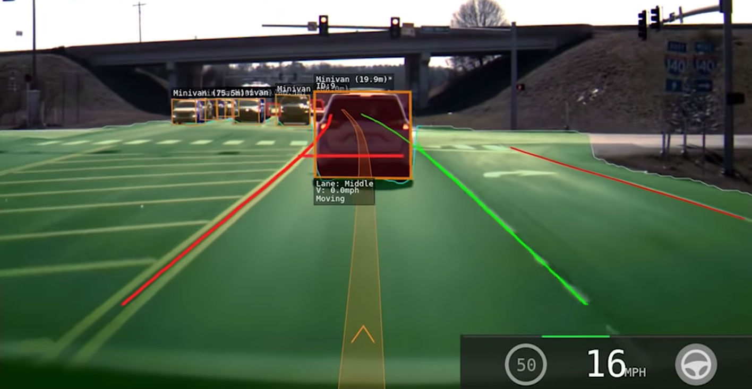
Tesla’s road detection

Slide 4
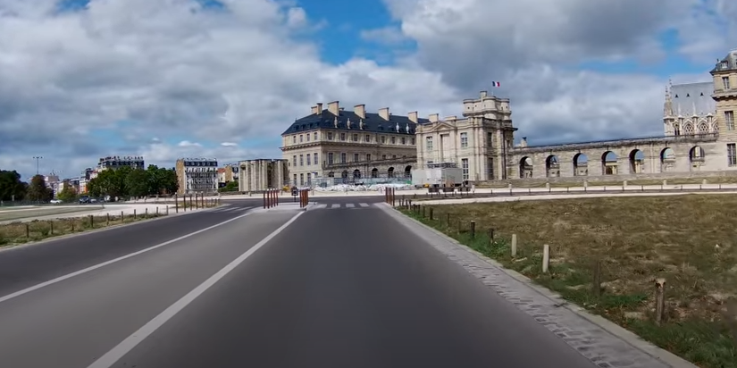
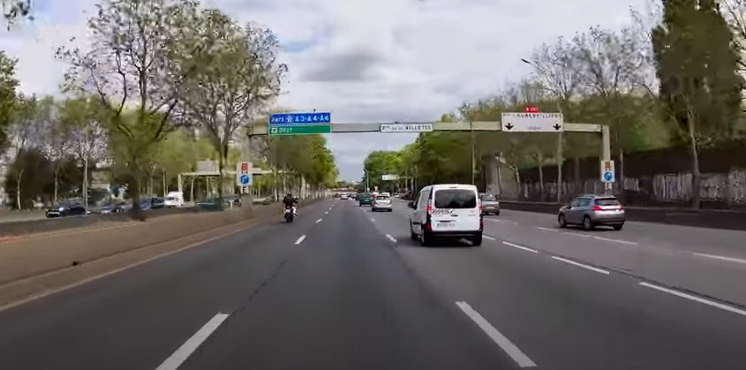
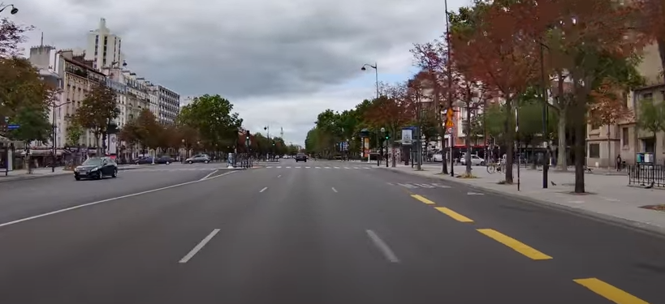
Lane detection

Slide 5
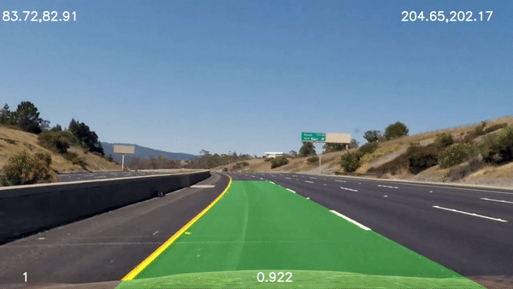
Our goal is…

Slide 6
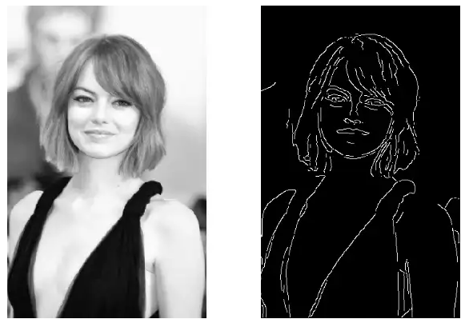
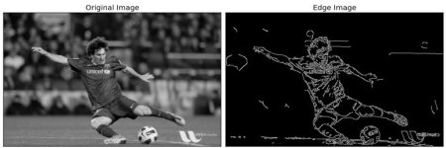
What we found so far
OpenCV - Canny Edge Detection

Slide 7
THANK YOU
Saffian
Emilio

